Slide 1
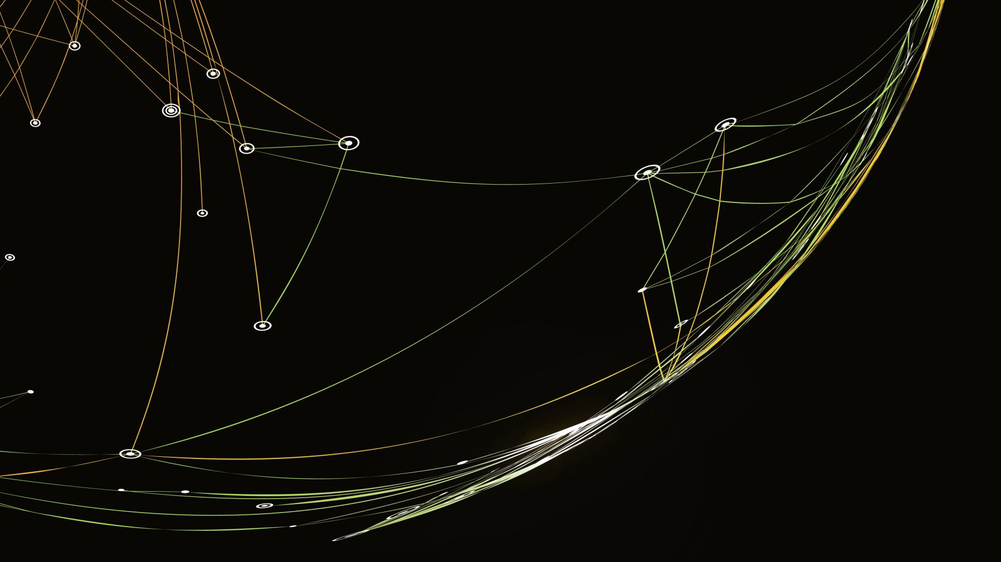

A. Hollis Wolf
Case Presentation
Competition
Notes:
Welcome to the A. Hollis Wolf Case Presentation Competition informational PowerPoint. We will be going over what A. Hollis Wolf is, some basic requirements, and the suggested process and deadlines.

Slide 2
What Is AHW?
“The goal of A. Hollis Wolf (AHW) Case Presentation Competition is to demonstrate the application of osteopathic principles through a case study. Students should discuss the patient diagnosis, associated somatic dysfunction(s) and appropriate treatment(s). Students should demonstrate overall clinical knowledge, including a discussion of why the osteopathic care was significant to the patient’s clinical outcome. A key component of the student’s presentation is an explanation of the student’s involvement in decision-making and treatment.” – SAAO Chapter Notebook
Notes:
To get started, what is A. Hollis Wolf? (Read Slide) This competition is designed to help foster critical thinking skills, improve osteopathic principles understanding, and develop understanding of Case Reports in order to further the osteopathic profession.

Slide 3

Requirements
One Presenter/Presentation Per School
Must be a National SAAO Member
Not a previous 1st place winner
No Mock Patients
Must be Original
Practice Run Through (March 8th)
5 minutes
Must Contain OMT
Notes:
A. Hollis Wolf Case Presentation is unique compared to most other case reports and competitions as far as requirements go. To start, there may be only one presenter for the presentation and each school is only allowed one representative. The presenter must be a National SAAO Member prior to submitting their presentation. For those that wish to participate again, you may not have been a previous 1st place winner. Because of the nature of A. Hollis Wolf discussing clinical benefit, no mock patients may be used. This must be original in that it was not presented previously at a national conference. All selected participants must be present for the practice run through the Friday of Convocation. Each presentation has a 5 minute limit and must contain OMT and Findings. For more in depth requirements, please refer to the Chapter Notebook’s A. Hollis Wolf section.

Slide 4
What Makes A Good Presentation?
Interesting
Unique
Evidence Based
Practice
Enthusiasm
Notes:
Having run this for several years and received feedback from judges, here are some suggestions on what makes a good presentation. The biggest one is make it interesting. If you find the case boring, chances are that it will come across in your presentation and be felt by the audience as boring. Many presentation have been ones that are either unique diagnoses or applications of techniques. It can be as simple as applying a technique in a new way that produced results or finally finding what worked for the patient in their situation. The more evidence based it can be, the better. Cite previous works, case reports, or even widely accepted books to help bolster your presentation. Be sure to practice your presentation. 5 minutes may seem like a lot of time, but it goes by in flash. Practicing your presentation also allows you to see where you would like to delve into information beyond your slides. One of the biggest things is ensuring you have energy and enthusiasm throughout your presentation. The audience is there to support you and listen to you. Engage them by using the stage and setting a clear pace to emphasize points you wish to highlight. Overall, be yourself and present in a way that feels comfortable to you.

Slide 5
Suggested Process With Deadlines
School Competition
Register and Submit Draft
Final Submission
Present
School Competition Late December or Early January
Participant Registration (January 14th)
  Submission of Presentation with Citations
Final Submission of Presentation (February 14th)
Practice and Present at Convocation (March 8th/9th)
Notes:
The suggested process with deadlines is laid out on this slide. It is recommended that the School Competition be held in late December or early January to allow for ample time for the winner to submit their preliminary presentation for citation review. You will then receive feedback on citations with the opportunity to correct any mistakes with a final submission deadline. You will then be expected to be present in person for the practice session, which is held the Friday of Convocation, and the competition day, held the Saturday of Convocation. For further details of deadlines, please refer to the Chapter Notebook.

Slide 6

Questions?
Vice Chair, saaovchair@academyofosteopathy.org
Local Chapter Leadership
Regional Coordinator
Notes:
Thank you so much for viewing this presentation. If there are any questions, please contact the SAAO Vice Chair at the email listed. You may also reach out to your local chapter leadership and Regional Coordinator as well. Thank you for your time and we hope that you will compete in this competition.

