Slide 1

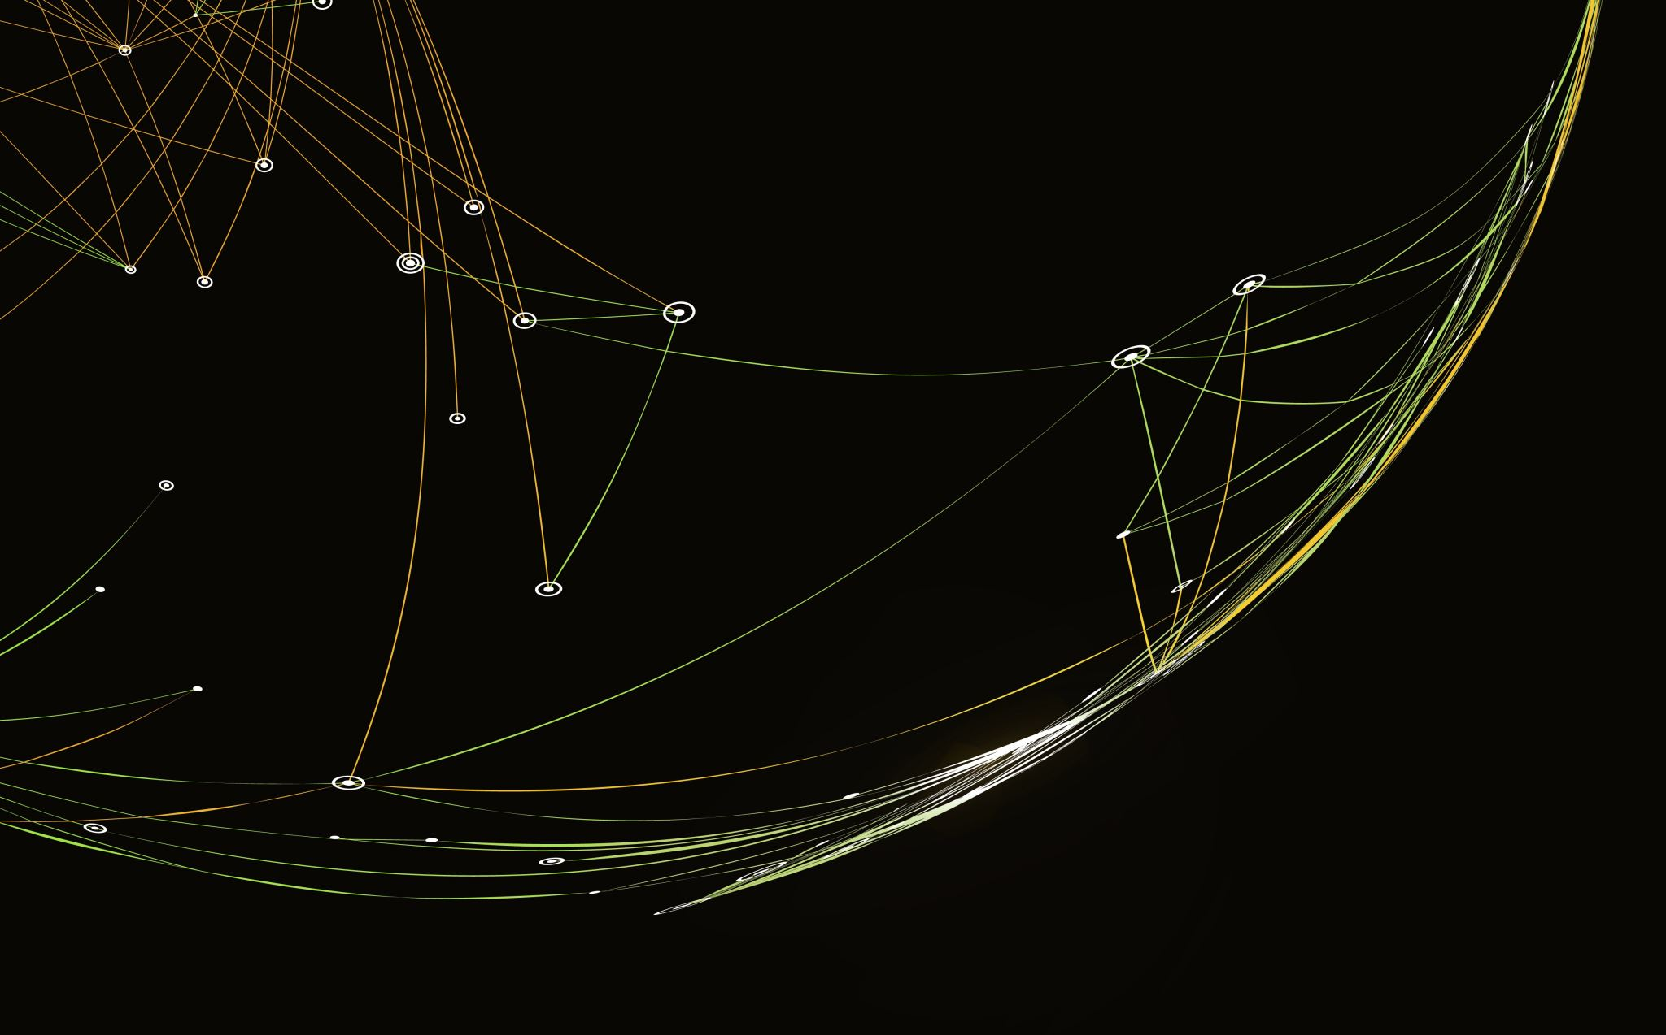

LBORC-NUFA
Research Poster
Presentation
Notes:
Welcome to the LBORC – NUFA Research Poster Presentation informational PowerPoint. We will be going over a little about the event, who may present, poster categories, requirements, as well as deadlines.

Slide 2
What Is LBORC-Nufa?
Louisa Burns Osteopathic Research Committee (LBORC) and the National Undergraduate Fellows Association (NUFA) hold a research poster presentation session during the American Academy of Osteopathy’s (AAO) annual Convocation.
Notes:
What is LBORC-NUFA? The Louisa Burns Osteopathic Research Committee (LBORC) and the National Undergraduate Fellows Association (NUFA) hold a research poster presentation session during the American Academy of Osteopathy’s annual Convocation. This opportunity is a fantastic way to begin your journey into presenting research or if you’re a seasoned researcher to get your work out to the osteopathic community.

Slide 3
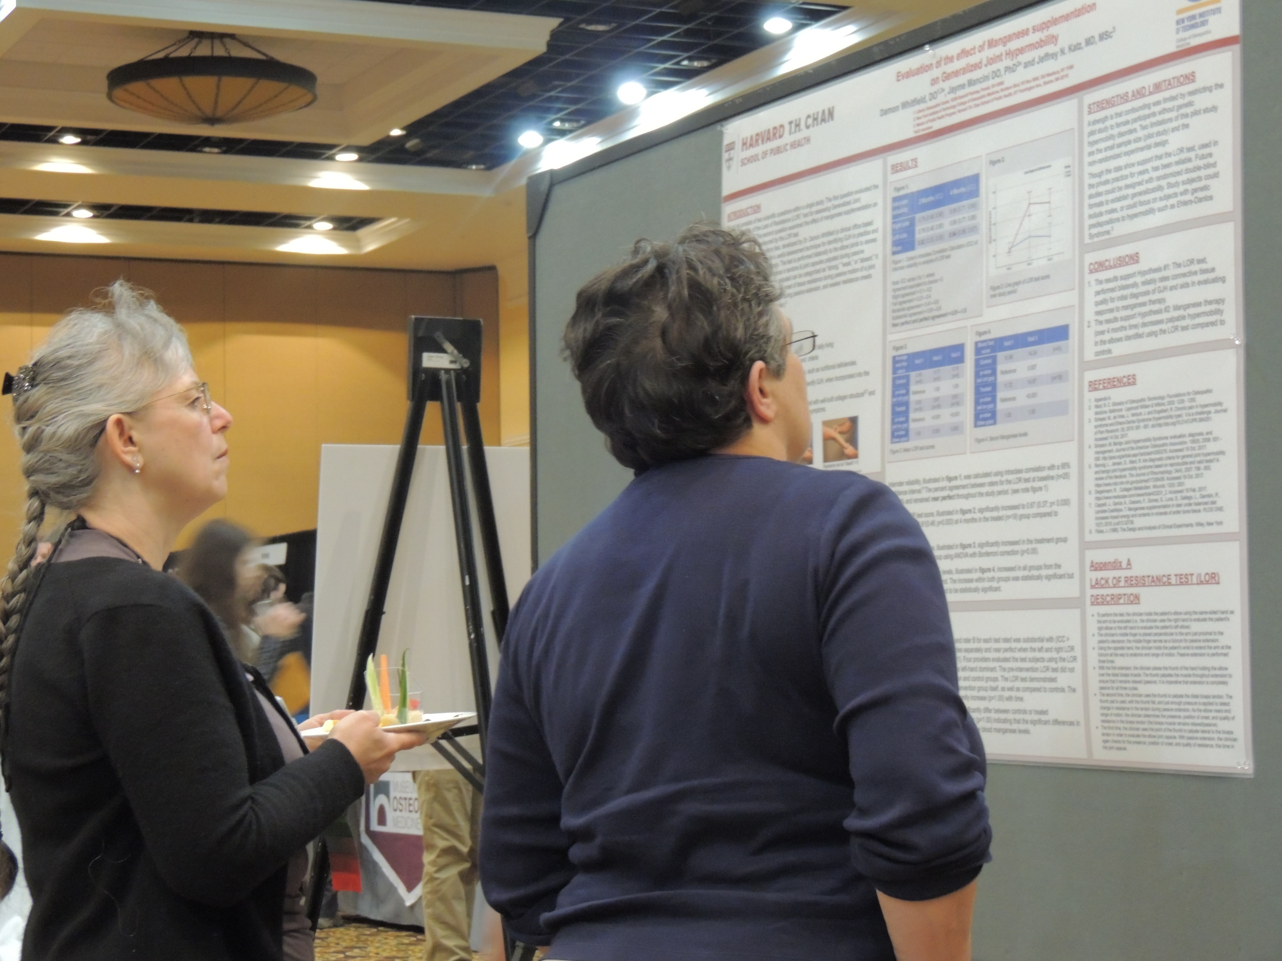
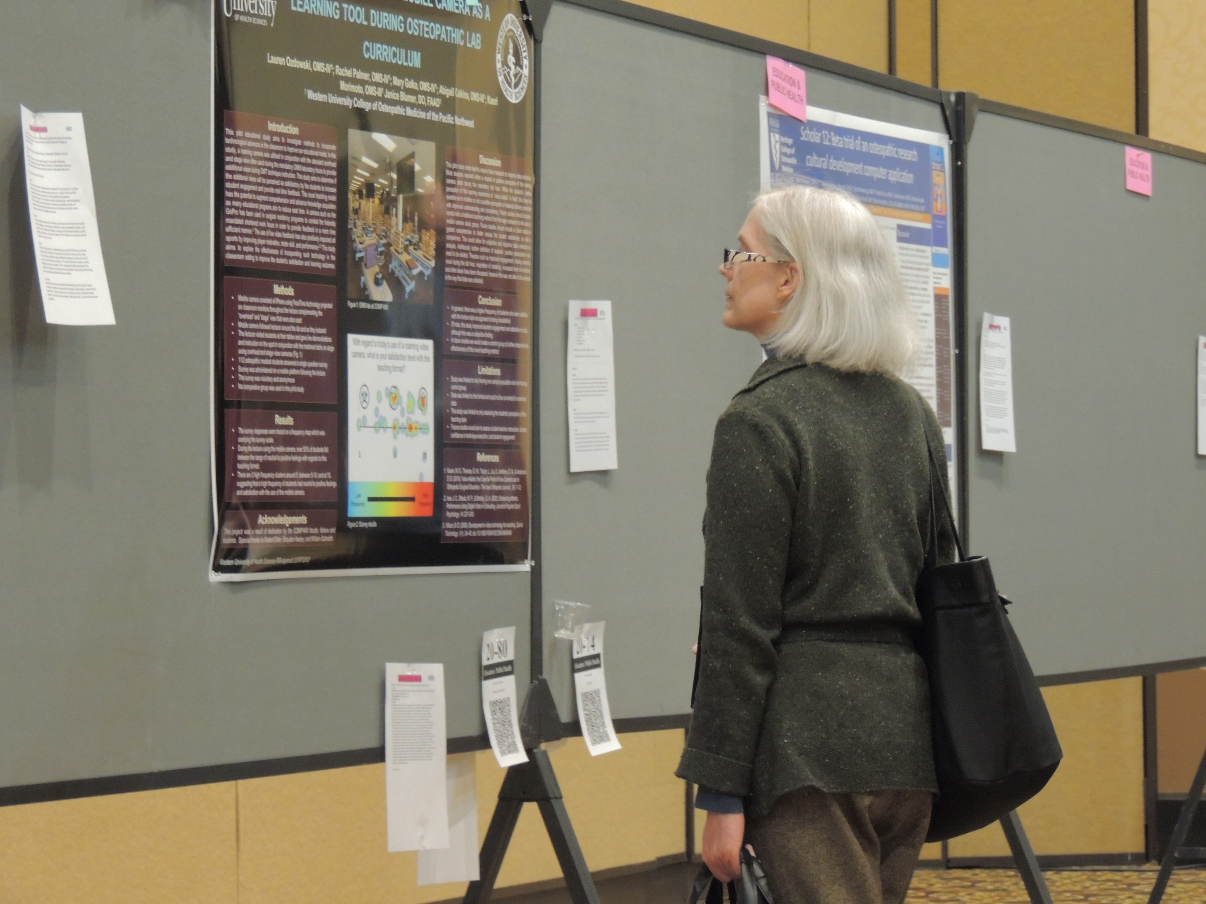
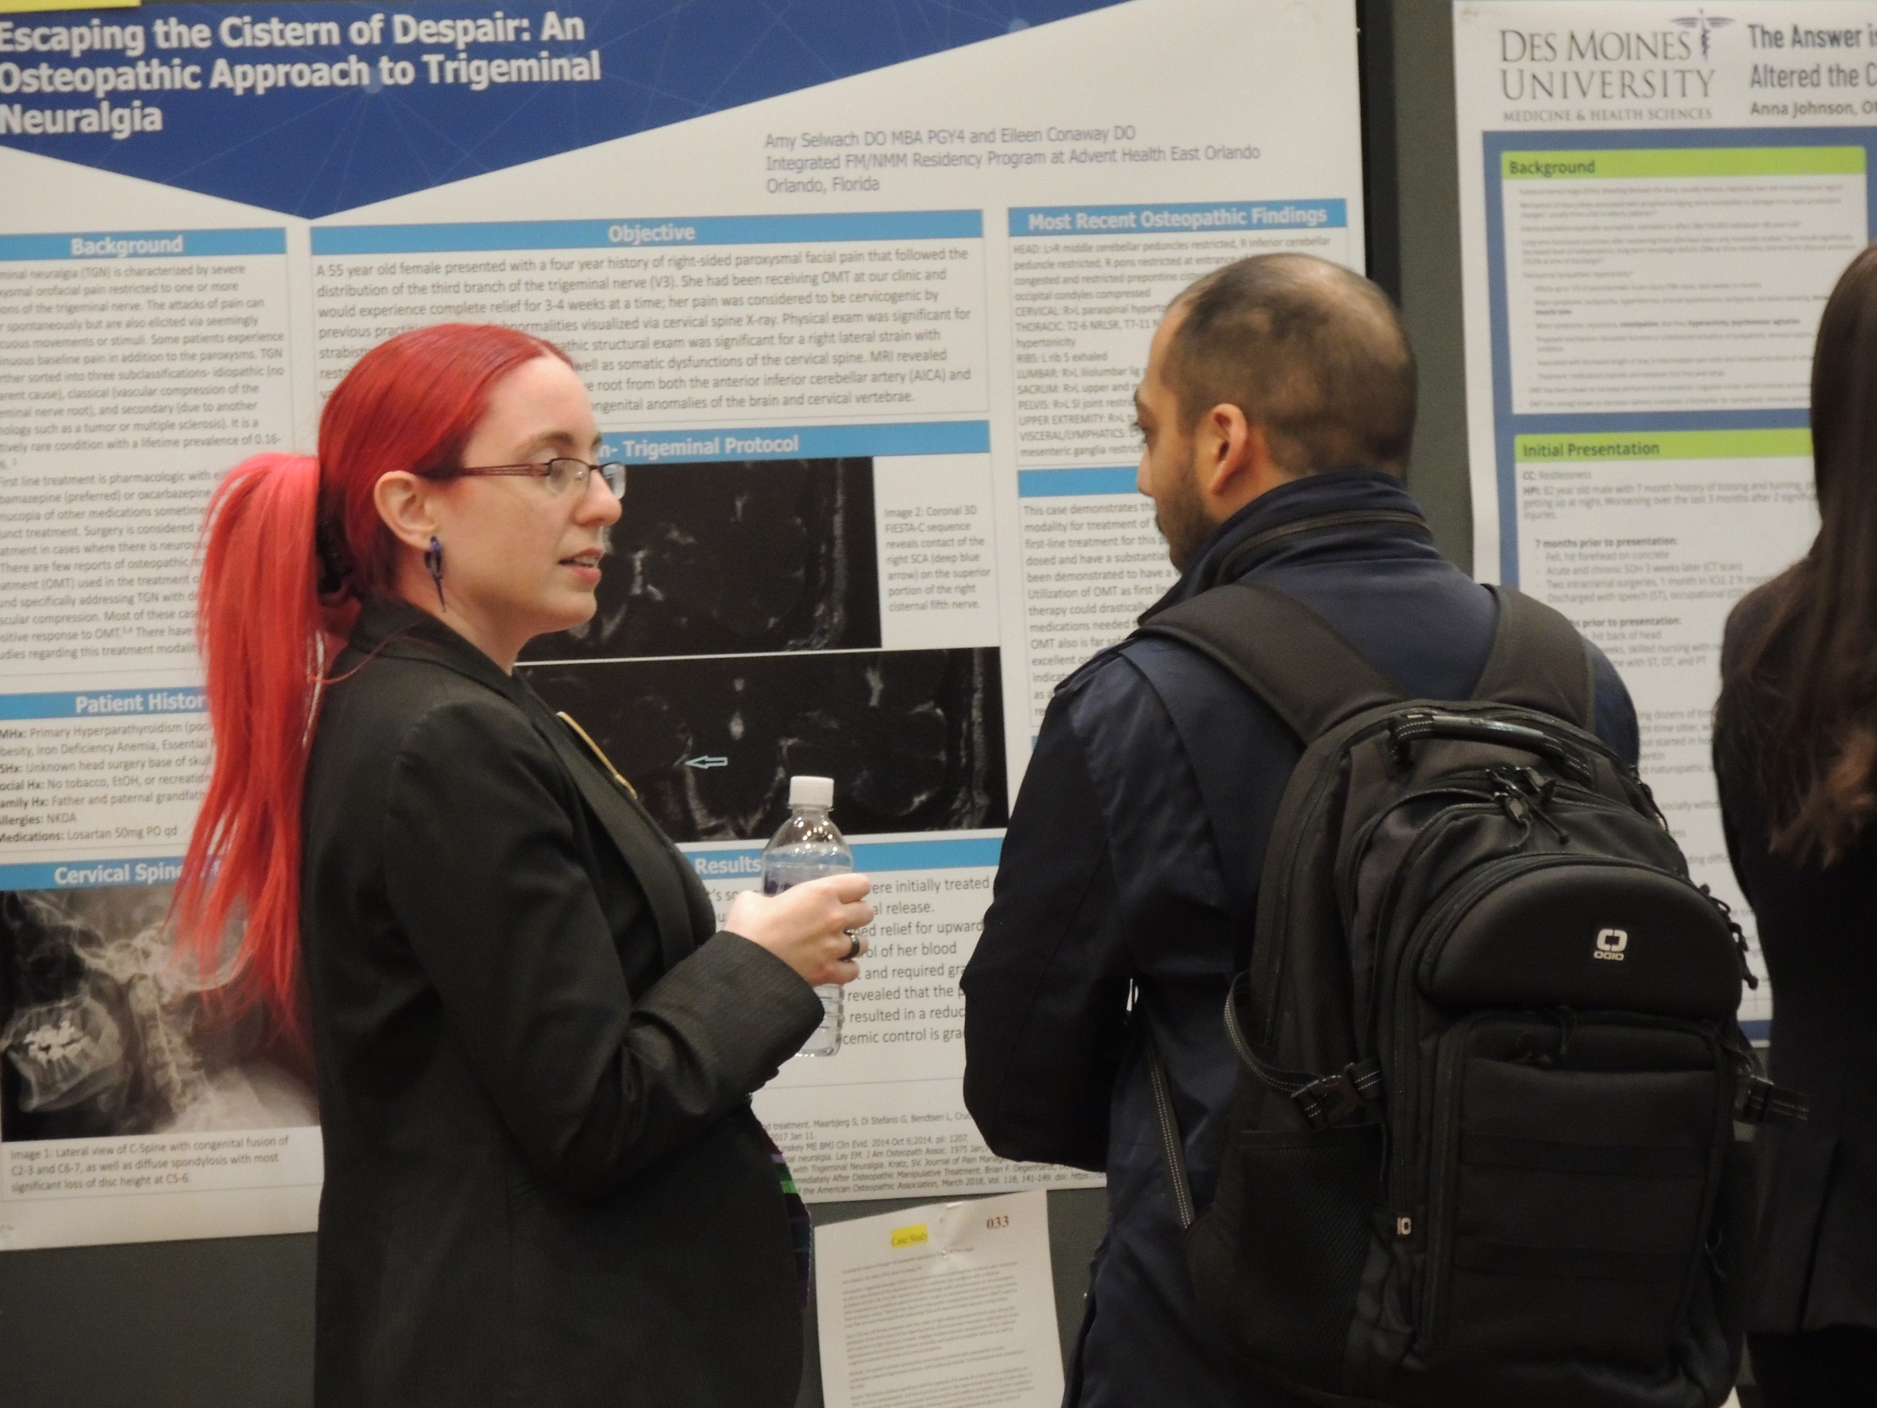
Who May Present?
Osteopathic Medical Students
Interns
Residents
Researchers
Practicing Physicians
Notes:
Many people present during this poster session. Osteopathic Medical Students, Interns, Residents, Physician and Non-physician researchers, and practicing physicians are just a few of those who have presented in the past.

Slide 4
Poster Categories
Student
Resident
  Original Research
  Education & Public Health
  Case Study
  Original Research
  Education & Public Health
  Case Study
Notes:
There are 3 poster categories that are further split into student or resident presenters. These categories are Original Research, Education and Public Health, and Case Studies. These are listed in order of preference deemed by the LBORC.

Slide 5

Requirements
First Author MUST:
  Be a member of the AAO, RAAO, or SAAO.
  Be present during the poster judging for student and resident posters.
All Presenters should register for Convocation
Visit the AAO Website for further details:
  https://www.academyofosteopathy.org/poster-presentations
Notes:
This slide goes over some requirements that are sometimes overlooked. The biggest one is that the First Author Must Be a member of the AAO, RAAO, or SAAO and be present during the poster judging for student and resident posters. All presenters should be registered for convocation to have access to the presenting hall. For further details and requirements, please visit the AAO Website for poster presentations.

Slide 6
Suggested Process With Deadlines
Dec. 4
Jan. 3
Jan. 26
Mar. 7
December 4: Early Submission
  Able to Get Comments and Make 1 Resubmission for Corrections!
January 3: All Poster Entries Due
January 26: Authors Notified
March 7: Poster Judging Session
Notes:
Here are the deadlines for this year. Early submissions are due by December 4th. This allows your abstract to be reviewed with comments along with the ability to resubmit with corrections. All final poster entries are due by January 3 with authors being notified of acceptance or rejections by January 26. The poster judging session will be held on March 7.

Slide 7

Questions?
SAAO Executive Council Vice Chair
  saaovchair@academyofosteopathy.org
Regional Coordinators
Local Chapter Leadership
Notes:
Thank you for viewing this presentation. If you have further questions, please reach out to the SAAO Vice Chair at the email listed. You may also contact your local chapter leadership or regional coordinator for further information. Thank you for your time and we hope you participate in this wonderful opportunity.

